Slide 1


Mathematics (End-sem) Project ADMM
ABIJITH PRADEEP
CB.EN.U4AIE19002

Slide 2

What is Optimization?
It is a mathematical method to find out the maximum value of a function or the minimum value of a function.
$$\begin{matrix}f(x)=100−{(x−6)}^{2} \\ \max_{x}f\left(x\right)=100\&\underset{x}{argmax}f\left(x\right)=6\end{matrix}$$

Slide 3
Constrained Optimization
Constrained optimization is the process of optimizing an objective function with respect to some variables in the presence of constraints on those variables.

Slide 4
Augmented Lagrangian Methods
Augmented Lagrangian methods are a certain class of algorithms for solving constrained optimization problems. They have similarities to penalty methods in that they replace a constrained optimization problem by a series of unconstrained problems and add a penalty term to the objective.

Slide 5
What is ADMM?
The Alternating Direction Method of Multipliers (ADMM) is an algorithm that solves convex optimization problems by breaking them into smaller pieces, each of which are then easier to handle.

Slide 6
Why ADMM?
It is almost 80 times faster for multivariable problems than conventional methods. ADMM put linear and quadratic programming in a single framework.

Slide 7



ADMM Basic Equation
$$\begin{matrix}minf\left(x\right)+g\left(z\right) \\ s.t...x=z\end{matrix}$$
$$L_{ρ}\left(x,y,z\right)=f\left(x\right)+g\left(x\right)+y^{T}\left(x−z\right)+\frac{ρ}{2}||x−z||_{2}^{2}$$
$$\begin{matrix}x^{k+1}:=\underset{x}{argmin}L_{ρ}\left(x,z^{k},y^{k}\right) \\ z^{k+1}:=argminL_{ρ}\left(x^{k+1},z,y^{k}\right) \\ y^{k+1}:=y^{k}+ρ\left(x^{k+1}−z^{k+1}\right)\end{matrix}$$

Slide 8
Topics Chosen
Linear Programming
Huber Fitting
SVM
Intersection of Polyhedra
Quadratic Programming
Lasso

Slide 9
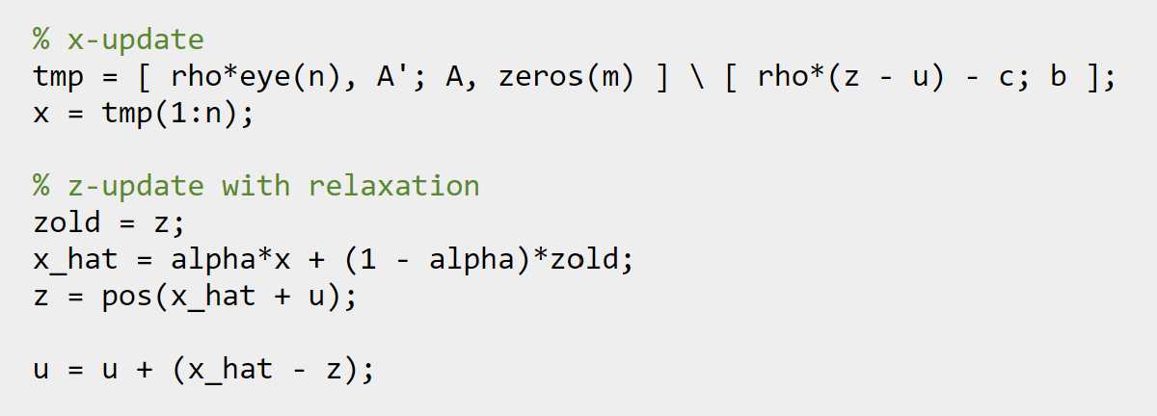
Linear Programming
minimize c’*x
subject to Ax = b, x >= 0
The solution is returned in the vector x
ADMM update
function obj = objective(c, x)
obj = c'*x;
end

Slide 10
function [z, history] = linprog(c, A, b, rho, alpha)
clc;
randn('state', 0);
rand('state', 0);
n = 50; % dimension of x
m = 40; % number of equality constraints
c = rand(n,1) + 0.5; % create nonnegative price vector with mean 1
x0 = abs(randn(n,1)); % create random solution vector
A = abs(randn(m,n)); % create random, nonnegative matrix A
b = A*x0;
[x history] = linprog(c, A, b, 1.0, 1.0);
disp(“Solution”);
disp(x);
Solution
0.7328 | 0.129 | 0.583 | 1.1664 | 2.5013
2.1156 | 1.8833 | 1.0466 | 1.6331 | 0
0.3903 | 0.1548 | 1.4883 | 0.7766
0.1604 | 0 | 1.3203 | 0.9586
0.7128 | 1.546 | 1.6644 | 1.4781
1.2491 | 0 | 1.3273 | 0.5776
1.5678 | 0 | 0.3797 | 0.9422
0.3038 | 0 | 0.0791 | 1.5964
0.4538 | 0.6614 | 0.7693 | 0
0 | 1.2706 | 0.5319 | 0
0 | 0.1294 | 1.5388 | 0.2652
0 | 1.4715 | 0.4805 | 1.0222

Slide 11
Notes:
R norm is x-z and S norm is -rho*(z-zold)

Slide 12
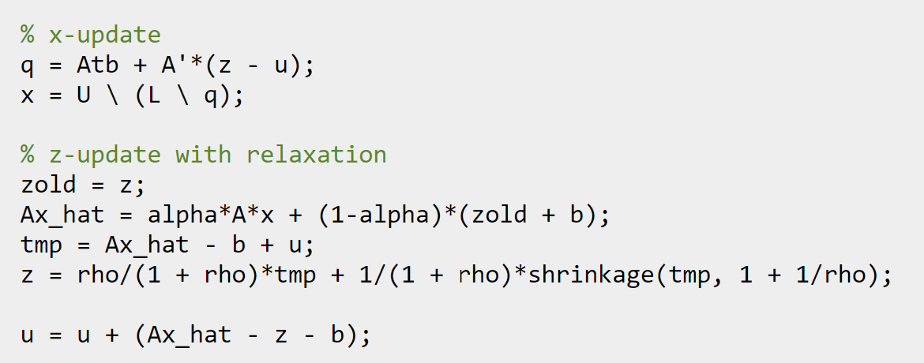
Huber Fitting
minimize 1/2*sum(huber(A*x - b))
with variable x.
The solution is returned in the vector x.
ADMM update
function p = objective(z)
p = ( 1/2*sum(huber(z)) );
end

Slide 13
[z, history] = huber_fit(A, b, rho, alpha);
clc;
m = 50; % number of examples
n = 20; % number of features
x0 = randn(n,1);
A = randn(m,n);
A = A*spdiags(1./norms(A)',0,n,n); % normalize columns
b = A*x0 + sqrt(0.01)*randn(m,1);
b = b + 10*sprand(m,1,200/m); % add sparse, large noise
[x history] = huber_fit(A, b, 1.0, 1.0);
disp("Solution");
disp(x);
Solution
6.041 | -5.1268
0.3503 | -0.7506
12.151 | 2.5697
3.8606 | 2.9342
4.6286 | -7.6882
5.1635 | 3.8288
8.2282 | -10.5817
3.5624 | -0.1679
0.1656 | -1.3707
-2.2918
10.1788

Slide 14
Notes:
R norm is x-z and S norm is -rho*(z-zold)

Slide 15
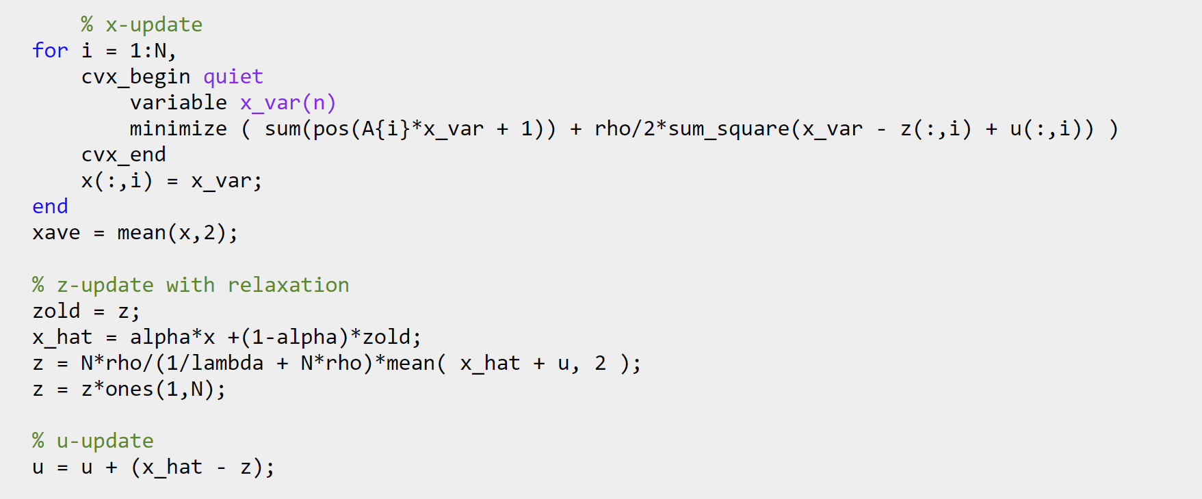
Support Vector Machine (SVM)
minimize (1/2)||w||_2^2 + lambda*sum( h_j(w, b))
The function h_j(w, b) is a hinge loss on the variables w and b.
It corresponds to h_j(w,b) = (Ax + 1), where x = (w,b).
The solution is returned in the vector x = (w,b)
ADMM update
function obj = objective(A, lambda, p, x, z)
obj = hinge_loss(A,x) + 1/(2*lambda)*sum_square(z(:,1));
end
Notes:
Distributed SVM

Slide 16
clc;
n = 2;m = 200;N = m/2;M = m/2;
% positive examples
Y = [1.5+0.9*randn(1,0.6*N), 1.5+0.7*randn(1,0.4*N);
2*(randn(1,0.6*N)+1), 2*(randn(1,0.4*N)-1)];
% negative examples
X = [-1.5+0.9*randn(1,0.6*M), -1.5+0.7*randn(1,0.4*M);
2*(randn(1,0.6*M)-1), 2*(randn(1,0.4*M)+1)];
x = [X Y];
y = [ones(1,N) -ones(1,M)];
A = [ -((ones(n,1)*y).*x)' -y'];
xdat = x';
lambda = 1.0;
% partition the examples up in the worst possible way
% (subsystems only have positive or negative examples)
p = zeros(1,m);
p(y == 1) = sort(randi([1 10], sum(y==1),1));
p(y == -1) = sort(randi([11 20], sum(y==-1),1));
[x history] = linear_svm(A, lambda, p, 1.0, 1.0);
disp("Solution");
disp(x);
Solution
-1.9527
-0.0976
0.1432

Slide 17
Notes:
R norm is x-z and S norm is -rho*(z-zold)

Slide 18
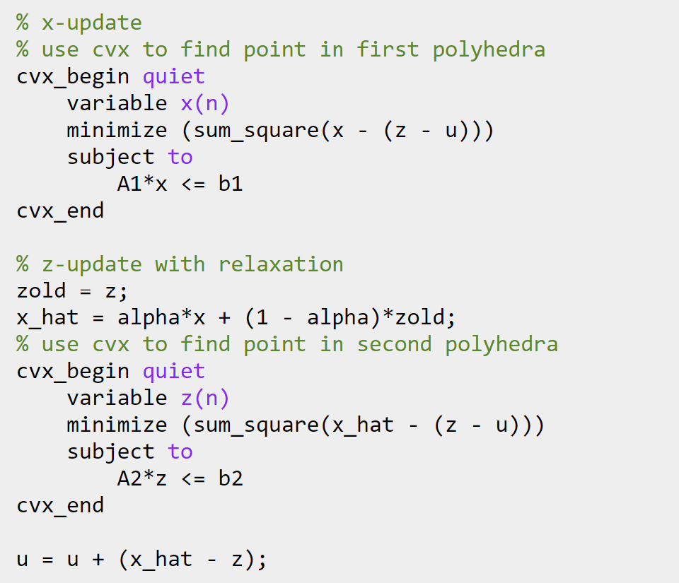
Intersection of Polyhedra
find x
subject to x in { y | A1 y <= b1 }
x in { y | A2 y <= b2 }.
ADMM update
The solution is returned in the vector x.

Slide 19
clc;
n = 5; % dimension of variable
m1 = 10; % number of faces for polyhedra 1
m2 = 12; % number of faces for polyhedra 2
c1 = 10*randn(n,1); % center of polyhedra 1
c2 = -10*randn(n,1); % center of polyhedra 2
A1 = diag(1 + rand(m1,1))*randn(m1,n);
b1 = diag(A1*(c1*ones(1,m1) + A1'));
A2 = diag(1 + rand(m2,1))*randn(m2,n);
b2 = diag(A2*(c2*ones(1,m2) + A2'));
cvx_begin quiet
variables x(n) y(n)
minimize sum_square(x - y)
subject to
A1*x <= b1
A2*y <= b2
cvx_end
% if the distance is not 0, expand A1 and A2 by a little more than half the
% distance
if norm(x-y) > 1e-4,
A1 = (1 + 0.5*norm(x-y))*A1;
A2 = (1 + 0.5*norm(x-y))*A2;
% recompute b's as appropriate
b1 = diag(A1*(c1*ones(1,m1) + A1'));
b2 = diag(A2*(c2*ones(1,m2) + A2'));
end
[x history] = linear_svm(A, lambda, p, 1.0, 1.0);
disp("Solution");
disp(x);
Solution
-0.000001343
-0.000008071
0.000003777
0.000005717
0.000003968

Slide 20
Notes:
R norm is x-z and S norm is -rho*(z-zold)

Slide 21
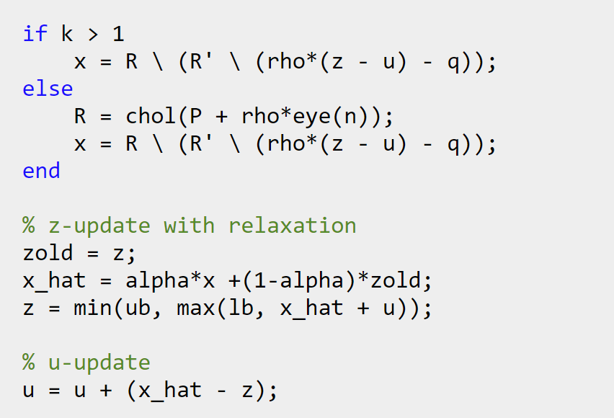
Quadratic Programming
minimize (1/2)*x'*P*x + q'*x + r
subject to lb <= x <= ub
The solution is returned in the vector x.
ADMM update
function obj = objective(P, q, r, x)
obj = 0.5*x'*P*x + q'*x + r;
end

Slide 22
clc;
n = 50;
% generate a well-conditioned positive definite matrix
% (for faster convergence)
P = rand(n);
P = P + P';
[V D] = eig(P);
P = V*diag(1+rand(n,1))*V';
q = randn(n,1);
r = randn(1);
l = randn(n,1);
u = randn(n,1);
lb = min(l,u);
ub = max(l,u);
[x history] = quadprog(P, q, r, lb, ub, 1.0, 1.0);
disp("Solution");
disp(x);
Solution
-0.0762 | -0.5443 | 1.0333 | 1.1801 | -0.61
-1.2587 | -0.5522 | -0.2045 | -0.8869 | -0.1475
-0.3628 | 0.7966 | -1.025 | -1.5754 | 0.9882
-0.0844 | -0.0141 | -0.6969 | 0.9311 | -1.1121
0.5591 | 0.2395 | 0.878 | 0.3789 | 0.4181
-0.3804 | 0.3708 | -0.2448 | -0.356 | -1.0643
-0.8494 | -0.7571 | -0.3639 | -0.6913
-0.4154 | 1.208 | -0.0172 | -0.9298
0.3832 | 0.2261 | -0.1872 | -0.1831
0.5447 | 0.8852 | -0.3695 | -0.2936
-0.4021 | 0.2305 | 1.3914 | -1.0737

Slide 23
Notes:
R norm is x-z and S norm is -rho*(z-zold)

Slide 24
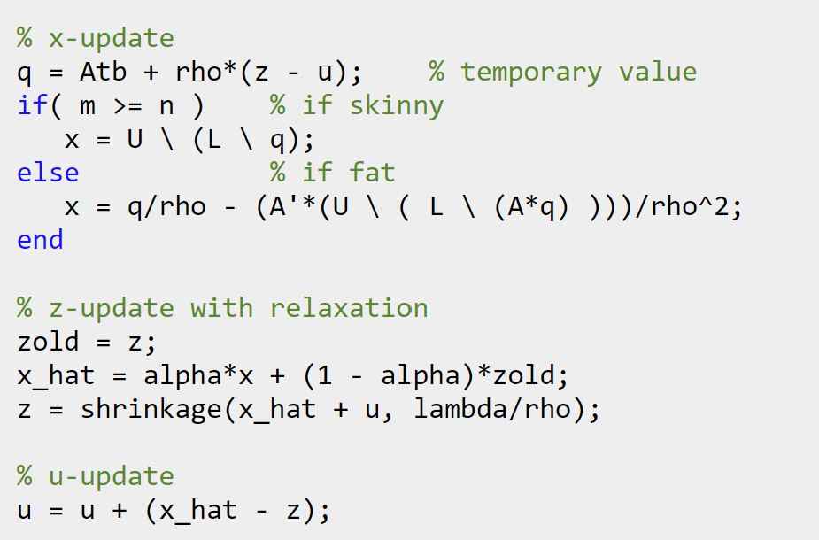
Lasso
minimize 1/2*|| Ax - b ||_2^2 + lambda* || x ||_1
The solution is returned in the vector x.
ADMM update
function p = objective(A, b, lambda, x, z)
p = ( 1/2*sum((A*x - b).^2) + lambda*norm(z,1) );
end

Slide 25
clc;
m = 150; % number of examples
n = 500; % number of features
p = 10/n; % sparsity density
x0 = sprandn(n,1,p);
A = randn(m,n);
A = A*spdiags(1./sqrt(sum(A.^2))',0,n,n); % normalize columns
b = A*x0 + sqrt(0.001)*randn(m,1);
lambda_max = norm( A'*b, 'inf' );
lambda = 0.1*lambda_max;
[x history] = lasso(A, b, lambda, 1.0, 1.0);
disp("Solution");
disp(x);
Solution
0 | 0 | 0 | 0 | 0
0 | 0 | 0 | 0 | 0
0 | 0 | 0 | 0 | 0
0 | 0 | 0 | 0 | 0
0 | 0 | 0 | 0 | 0
0 | 0 | 0 | 0 | 0
0 | 0 | 0 | 0 | 0
0 | 0 | 0 | 0 | 0
0 | 0 | 0 | 0 | 0
0.7093 | 0 | 0 | 0 | 0

Slide 26
Notes:
R norm is x-z and S norm is -rho*(z-zold)

